Slide 1
Intents and Passing Data through Intents in Android
Sulaxan Jadhav

Slide 2
Introduction to Intents
What are Intents?
Understanding the Intent Object
Use Cases of Intents
Explicit Intents
What are Explicit Intents?
Launching an Activity with Explicit Intent
Hands-on Example: Explicit Intents
Implicit Intents
What are Implicit Intents?
Using Implicit Intents to Trigger System Actions
Broadcast Intents and Receivers
Hands-on Example: Implicit Intents

Slide 3
Passing Data through Intents
Sending Data Using Intents
Receiving Data in the Target Activity
Parcelable vs Serializable
Hands-on Example: Passing Complex Data
Advanced Topics and Best Practices
Intent Flags
Pending Intents
Security Considerations
Hands-on Example: Using Pending Intents

Slide 4
Introduction to Intents
What are Intents?
Definition and purpose in Android.
Types of Intents: Explicit and Implicit Intents.
Role of Intents in navigation and communication between components.
Understanding the Intent Object
Overview of key components: Action, Data, Category, Type, Extras, Flags.
Creating and using Intent objects.
Demo: Basic Intent creation and usage.

Slide 5
What are Intents?
Definition:
An Intent is an Android object that allows communication between different components of an app or between apps.
It signals an app that a particular action is needed (like opening another activity or sending data).
Purpose:
Intents are crucial for app navigation, launching components, passing data, starting background services, and broadcasting system messages.
They allow components to work independently and trigger events without tight coupling.
Types of Intents:
Explicit Intents: Used to start specific components (e.g., navigating from one activity to another within the same app).
Implicit Intents: Used to request actions from other apps or system components (e.g., opening a webpage or sharing content). The system determines which app can handle the request.

Slide 6
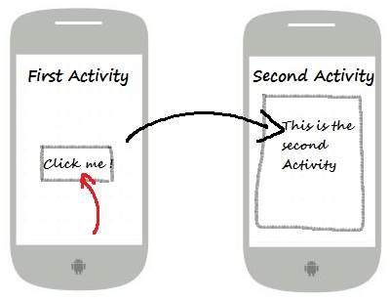

Slide 7
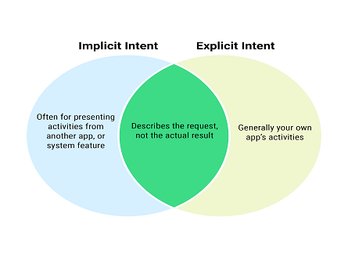

Slide 8
Role of Intents in Navigation and Communication
Navigation Using Intents
Key Role: Intents are essential for moving between activities, services, or fragments within an app.
Example: A common use case is navigating from a Login Screen to the Main Dashboard once a user successfully logs in.
Explicit Intent: In this scenario, an explicit Intent is used to specify the destination activity.
Intent intent = new Intent(LoginActivity.this, MainActivity.class);
startActivity(intent);
User Flow: This navigation is crucial for guiding users through different screens and actions in an app. It helps create a smooth user experience by controlling the flow between activities.

Slide 9
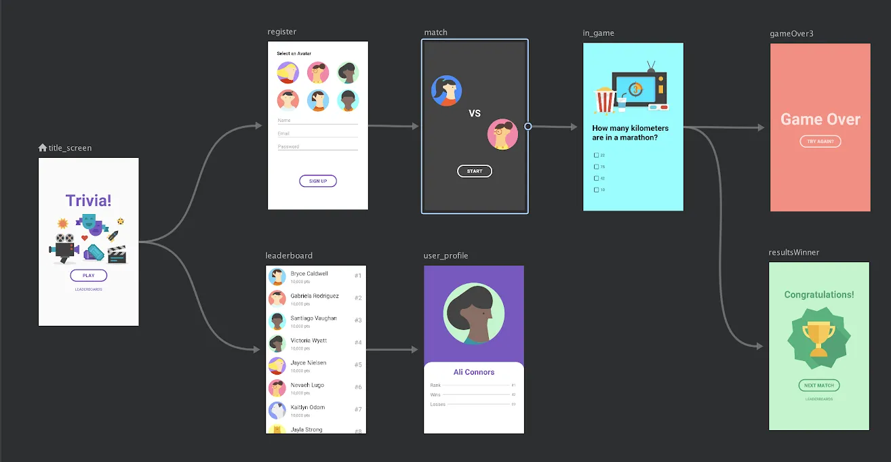

Slide 10
2. Component Communication Using Intents
Intent as a Messenger: Intents facilitate communication between different app components such as activities, services, and broadcast receivers without directly accessing them.
Example: An Intent can start a background service for downloading files, or trigger a broadcast message when an event occurs (e.g., battery low).
Intent intent = new Intent("android.intent.action.BATTERY_LOW");
sendBroadcast(intent);
Modularity and Separation of Concerns: Intents allow components to communicate indirectly. This keeps components decoupled, making it easier to maintain and scale the app.
Example: A service can notify the UI to update via a broadcast receiver without needing direct access to the UI component.
Efficiency: With Intents, different components can work independently but still communicate when necessary, increasing flexibility in app design.

Slide 11
Understanding the Intent Object
The Intent Object is a core part of Android's framework, enabling communication between app components or between different apps.

Slide 12
1. Key Components of the Intent Object
a) Action
The Action defines the general operation that the Intent should perform.
Common Actions:
Intent.ACTION_VIEW: Used for viewing something (e.g., opening a URL in the browser).
Intent.ACTION_SEND: Used for sending data to other apps (e.g., sharing text or images).

Slide 13
Example: // Opening a URL in a browser using ACTION_VIEW
Intent intent = new Intent(Intent.ACTION_VIEW);
intent.setData(Uri.parse("http://www.example.com"));
startActivity(intent);

Slide 14
b) Data
The Data component of the Intent specifies the data that the action is supposed to act upon.
It is typically in the form of a URI (Uniform Resource Identifier), such as a URL.
Example:
Opening a webpage: Uri.parse("http://www.example.com")
Dialing a number: Uri.parse("tel:1234567890")
Combined Example: Intent intent = new Intent(Intent.ACTION_VIEW);
intent.setData(Uri.parse("http://www.example.com"));
startActivity(intent);

Slide 15
c) Category
Category gives additional information about the action, helping to narrow down the list of components that can handle the Intent.
Common Category:
Intent.CATEGORY_DEFAULT: This is applied by default if no specific category is provided.
Intent.CATEGORY_BROWSABLE: This allows an activity to be launched by a web browser.
Example: intent.addCategory(Intent.CATEGORY_DEFAULT);

Slide 16
d) Type
The Type specifies the MIME Multipurpose Internet Mail Extensions type of the data. It defines the format of the content that is being passed (e.g., text, image, video).
Examples:
image/* for images.
text/plain for plain text.
Setting Type: Intent intent = new Intent(Intent.ACTION_SEND);
intent.setType("image/*"); // Specifies that the intent is to send an image

Slide 17
e) Extras
Extras are additional data you can attach to an Intent. These can include key-value pairs of various data types like strings, integers, arrays, and even objects.
Common Methods:
putExtra(String name, String value): Passes a simple string value.
putExtras(Bundle bundle): Passes a bundle of extras.
Example: Intent intent = new Intent(CurrentActivity.this, TargetActivity.class);
intent.putExtra("EXTRA_USERNAME", "JohnDoe");
startActivity(intent);

Slide 18
f) Flags
Flags are special instructions on how an activity should be launched, affecting the activity’s behavior in relation to the task stack.
Common Flags:
FLAG_ACTIVITY_NEW_TASK: Starts the activity in a new task.
FLAG_ACTIVITY_CLEAR_TOP: If the target activity is already in the task, it clears all other activities on top of it.
Example: Intent intent = new Intent(CurrentActivity.this, TargetActivity.class);
intent.setFlags(Intent.FLAG_ACTIVITY_NEW_TASK | Intent.FLAG_ACTIVITY_CLEAR_TOP);
startActivity(intent);

Slide 19
2. Creating and Using Intent Objects
a) Explicit Intents
Used when you know the specific component (like an Activity or Service) you want to start.
Example: // Create an explicit Intent to navigate to a specific Activity
Intent intent = new Intent(CurrentActivity.this, TargetActivity.class);
startActivity(intent);
Explanation:
CurrentActivity.this: Refers to the current activity’s context.
TargetActivity.class: Specifies the destination activity to be opened.

Slide 20
b) Implicit Intents
Used when you don’t know the exact component but want to trigger an action (e.g., opening a webpage, sending an email).
Example:
// Create an implicit Intent to open a webpage
Intent intent = new Intent(Intent.ACTION_VIEW);
intent.setData(Uri.parse("http://www.example.com"));
startActivity(intent);
Explanation:
Intent.ACTION_VIEW: Action to view something, in this case, a URL.
setData(Uri): Specifies the data (in this case, the URL to open).

Slide 21
Explicit Intents
Explicit Intents are used when you know the specific target component (such as an Activity or Service) you want to start.

Slide 22
1. What are Explicit Intents?
Definition:
Explicit Intents are used to communicate directly with a known component within the same application or, less commonly, another app. These are mainly used for activity-to-activity communication, but they can also be used to start services or broadcast receivers within an app.
Purpose: Explicit Intents specify the exact class to handle the Intent, unlike Implicit Intents, where the system finds the right component to handle the action.
Use Case:
For example, you want to navigate from a login screen to a dashboard after successful authentication. You know exactly which activity (DashboardActivity) to open.

Slide 23
Syntax and Structure:
The basic structure for an Explicit Intent involves:
Specifying the source (current activity).
Specifying the target (destination activity or component).
Optionally passing data using Extras.

Slide 24
2. Launching an Activity with Explicit Intent
Steps for Launching an Activity:
To navigate from one activity to another using Explicit Intent:
Create the Intent: Define the source and target activities.
Pass any data (if needed): Use the putExtra() method to pass data from one activity to another.
Start the Activity: Call startActivity(intent) to launch the target activity.

Slide 25
Passing Control Between Activities:
The control flow switches from the current activity to the target activity when the startActivity() method is called. The target activity becomes the foreground, while the current activity goes into the background or is destroyed (depending on its lifecycle).
Starting an Activity and Expecting a Result (startActivityForResult()) (10 minutes):
Sometimes, you start an activity expecting some data to be returned. For example, an app might open a camera activity to capture a photo and expect the result (the photo) to be returned to the previous activity.
Method: Use startActivityForResult(Intent intent, int requestCode) to start the activity and specify a request code to identify the result.
Receiving the Result: Override onActivityResult() in the source activity to handle the returned data.

Slide 26
Implicit Intents
Implicit Intents are a powerful way to let Android decide which component (activity, service, etc.) should handle a request. Unlike Explicit Intents, where you specify the exact target, Implicit Intents are used for more generalized actions like opening a webpage, sending an email, or sharing content across apps.

Slide 27
1. What are Implicit Intents?
Implicit Intents in Android are used to request actions from components without specifying the exact component that should handle the action.
Instead, they declare a general action to be performed, such as viewing a webpage or dialing a phone number, and allow the Android system to determine which app or component can handle the request.
This decision is made by matching the Intent against the Intent Filters declared by various apps in their AndroidManifest.xml.

Slide 28
Purpose:
The main purpose of Implicit Intents is to let the system dynamically select an app or service capable of completing the requested action.
This is useful in scenarios where:
You don’t know or don’t need to know which specific app will handle the request (e.g., launching a browser, opening a document, or sending an email).
You want to give users the flexibility to choose between different apps that can handle the same action (e.g., sharing content via different social media apps).

Slide 29
Use Cases:
Opening external links: If you want your app to open a URL, you can trigger a browser or any app that supports web pages without specifying a particular browser.
Example: Opening a webpage using Intent.ACTION_VIEW.
Dialing a phone number or sending an SMS: You can let the system choose the phone or SMS app for communication.
Example: Dialing a phone number with Intent.ACTION_DIAL.
Sharing content with other apps: Allow users to share text, images, or files across different apps.
Example: Sharing an image on social media via Intent.ACTION_SEND.
Triggering system actions: You can trigger system services like capturing a photo, sending an email, or opening a contact picker.
Example: Sending an email with Intent.ACTION_SENDTO.

Slide 30
How It Works:
System Identification: When an Implicit Intent is sent, the Android system checks all the installed apps to see if any have registered Intent Filters in their AndroidManifest.xml that match the action, data, and category specified by the Intent.
Intent Filters include attributes like:
Action: The general action to perform (e.g., ACTION_VIEW, ACTION_SEND).
Data: Specifies the data type or format (e.g., a URL, a phone number).
Category: Provides additional information (e.g., CATEGORY_DEFAULT for default app handling).
App Selection: If one app matches the Intent's action and data, the system directly launches that app. If multiple apps match, the system presents a chooser dialog allowing the user to select which app to use.

Slide 31
2. Using Implicit Intents to Trigger System Actions
Triggering Common System Actions:
Implicit Intents are commonly used for system-level tasks such as opening a webpage, dialing a phone number, sending an email, or sharing content.
a) Opening a Webpage:
To open a webpage, we can create an Intent with Intent.ACTION_VIEW and a data URI pointing to the webpage URL.
Code Example: Intent intent = new Intent(Intent.ACTION_VIEW);
intent.setData(Uri.parse("http://www.example.com"));
startActivity(intent);

Slide 32
b) Dialing a Phone Number:
If you want to dial a phone number, you can use Intent.ACTION_DIAL with the appropriate phone number.
Code Example: Intent intent = new Intent(Intent.ACTION_DIAL);
intent.setData(Uri.parse("tel:+123456789"));
startActivity(intent);

Slide 33
c) Sending an Email:
For sending an email, you can use Intent.ACTION_SENDTO with the appropriate email URI and subject line.
Code Example: Intent intent = new Intent(Intent.ACTION_SENDTO);
intent.setData(Uri.parse("mailto:example@example.com"));
intent.putExtra(Intent.EXTRA_SUBJECT, "Subject of the Email");
startActivity(intent);

Slide 34
d) Sharing Content:
Sharing content like text, images, or videos can be done using Intent.ACTION_SEND. For example, sharing a message or an image with other apps like social media or messaging apps.
Code Example (Sharing Text): Intent intent = new Intent(Intent.ACTION_SEND);
intent.setType("text/plain");
intent.putExtra(Intent.EXTRA_TEXT, "This is a sample message.");
startActivity(Intent.createChooser(intent, "Share via"));

Slide 35
How the System Determines Components:
When an Implicit Intent is invoked, the Android system compares the action, data, and category in the Intent with the registered Intent Filters in each app’s AndroidManifest.xml file.
If an app has defined an appropriate Intent Filter that matches the action and data, it will be a candidate to handle the Intent.
If more than one app matches, a chooser dialog will be displayed to the user.

Slide 36
3. Syntax and Working of Intent Filters in AndroidManifest.xml
What is an Intent Filter?
An Intent Filter in Android defines the types of intents that a component (activity, service, or broadcast receiver) can handle. When an app component wants to declare its capability to handle certain actions, it uses Intent Filters in the AndroidManifest.xml file. This allows the system to identify which component should respond to a given intent.
Intent Filters act like "declarations" that help the Android system determine which apps or components can respond to specific actions.
These filters are essential when working with Implicit Intents, as they help match the action requested by the user to a suitable app.

Slide 37
Structure of an Intent Filter:
An Intent Filter is composed of three key parts: Action, Category, and Data. These components allow developers to specify the exact types of intents their app can respond to.
Syntax of an Intent Filter:
<activity android:name=".MyActivity">
<intent-filter>
<action android:name="android.intent.action.VIEW" />
<category android:name="android.intent.category.DEFAULT" />
<data android:scheme="http" />
<data android:scheme="https" />
</intent-filter>
</activity>
This block of code is placed in the AndroidManifest.xml file, typically inside the <application> tag. It defines an activity (MyActivity) that can handle actions related to viewing web pages over HTTP and HTTPS protocols.

Slide 38
Components of an Intent Filter:
Action:
Definition: Specifies the general action to perform. For example, android.intent.action.VIEW tells the system that the component is capable of "viewing" content.
Example: xml Copy code <action android:name="android.intent.action.VIEW" />
Other common actions:
android.intent.action.SEND: Used for sharing data.
android.intent.action.DIAL: Used to open the phone dialer with a number.
android.intent.action.EDIT: Used to edit an existing item.

Slide 39
Category:
Definition: Provides additional information about the action being performed. Common categories include DEFAULT and BROWSABLE.
Example: xml Copy code <category android:name="android.intent.category.DEFAULT" />
Other categories:
android.intent.category.BROWSABLE: Used for web browsers.
android.intent.category.LAUNCHER: Marks activities that should be listed in the app launcher.

Slide 40
Data:
Definition: Specifies the type of data the component can handle, including URIs and MIME types. This is particularly useful for handling specific types of content, such as URLs, images, or text.
Example: xml Copy code <data android:scheme="http" />
<data android:scheme="https" />
Other data attributes:
android:mimeType="image/*": Used for handling images.
android:pathPattern=".*\\.pdf": Used for opening PDF files.

Slide 41
How Intent Filters Work:
Intent Matching: When the Android system receives an implicit intent (e.g., opening a webpage), it scans the Intent Filters registered in all installed apps to find those that match the action, data, and category of the intent.
System Chooser: If multiple apps are capable of handling the intent (e.g., multiple browsers for opening a URL), the system displays a chooser dialog, allowing the user to pick an app.
Component Launch: Once the user selects an app, the system launches the corresponding component (activity, service, or receiver) to handle the request.

Slide 42
4. Broadcast Intents and Receivers
Broadcast Intents allow Android to send messages or notifications to multiple apps or components simultaneously.
They are used to inform apps about system-wide events or events within a specific app.
The broadcast mechanism is an efficient way for apps to stay updated about certain changes without running continuously.

Slide 43
Types of Broadcasts:
System Broadcasts:
Definition: These are broadcast Intents sent by the Android system when certain system-wide events occur.
Examples:
android.intent.action.BOOT_COMPLETED: Sent when the device finishes booting.
android.intent.action.BATTERY_LOW: Sent when the device’s battery is low.
android.intent.action.SCREEN_OFF: Sent when the screen is turned off.
Purpose: System broadcasts keep apps informed about changes in the device state, such as connectivity changes, power conditions, and more, enabling them to take appropriate action.
Custom Broadcasts:
Definition: Custom broadcasts are sent by apps to notify other components, either within the same app or to external apps, about certain events.
Examples:
An app might broadcast a custom intent when a significant event happens, such as a file being downloaded or an important task being completed.
Purpose: Custom broadcasts are useful for communication between components of an app or between different apps.
Purpose of Broadcasts:
Efficiency: Broadcasts allow apps to be notified about important events without the need to run continuously in the background. This conserves system resources and battery life.
Reactivity: Apps can take specific actions when receiving a broadcast. For example, if the system sends a low battery broadcast, an app could reduce its background activity or change its behavior to conserve battery.

Slide 44
Broadcast Receivers:
A Broadcast Receiver is a component that listens for broadcast Intents and responds to them. It acts as a middleman between the system or other apps that send broadcasts and the app that needs to respond to those broadcasts.
Registration:
Broadcast Receivers can be registered in two ways:
Statically in the AndroidManifest.xml file.
Dynamically through code while the app is running.
Response: When a Broadcast Receiver catches a broadcast, it triggers the onReceive() method, where the app defines the actions to be taken in response to the broadcast.

Slide 45
Registering a Broadcast Receiver:
Static Registration (AndroidManifest.xml):
Static receivers are declared in the AndroidManifest.xml, making them persistent across app restarts. However, Android 8.0 (API level 26) introduced restrictions on statically registering for system broadcasts.
Example of a static receiver: <receiver android:name=".BootReceiver" android:enabled="true" android:exported="false">
<intent-filter>
<action android:name="android.intent.action.BOOT_COMPLETED" />
</intent-filter>
</receiver>
In this example, the BootReceiver class will be triggered when the system broadcasts BOOT_COMPLETED (when the device finishes booting).

Slide 46
Dynamic Registration (Programmatically):
Dynamic receivers are registered while the app is running and can be unregistered when no longer needed. They are useful when the receiver should only be active for a specific period.
Example of dynamic registration: IntentFilter filter = new IntentFilter(Intent.ACTION_BATTERY_LOW);
BroadcastReceiver receiver = new BroadcastReceiver() {
@Override
public void onReceive(Context context, Intent intent) {
// Handle the broadcast event here
}
};
registerReceiver(receiver, filter);
In this case, the receiver listens for the BATTERY_LOW broadcast only while the app is running and can be unregistered when it is no longer needed.

